Slide 1
Botnet Detection with Ensemble Fusion Machine Learning Method
Research Proposal progress Report
Thanawat Tejapijaya
27/7/2023

Slide 2
Botnet Detection with Fusion Machine Learning Method
Research Proposal progress Report
Thanawat Tejapijaya
24/7/2023

Slide 3
Content
Feature Extraction
Train and Test each file separately
Fusion Technique
Future Work

Slide 4
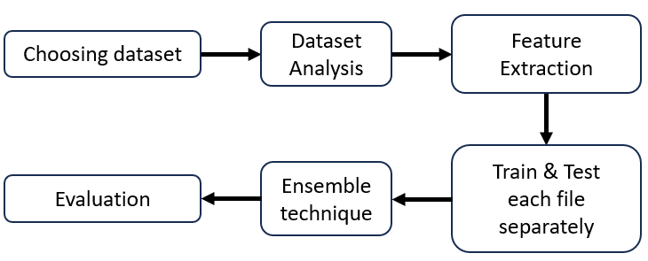
Feature Extraction
Fusion
Model

Slide 5
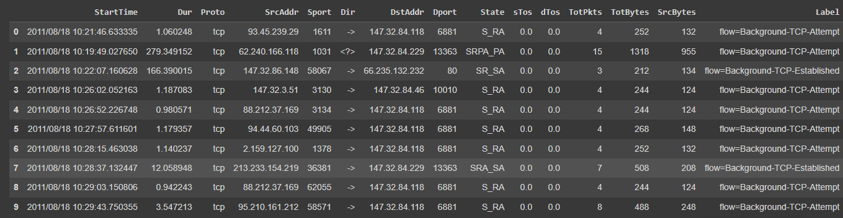
Feature Extraction
Window width 120 seconds and slide 60 seconds^{2,3}
One window (width = 120 seconds)
Figure: Example of how each subgroup was chosen and how window slide was performed.

Slide 6
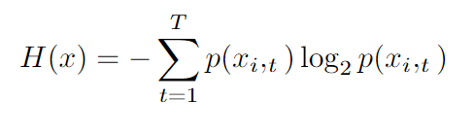
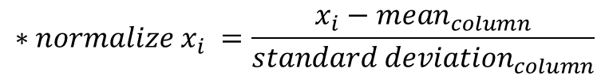
Data Preprocessing(2)
$$∗{normalize x}_{i} =\frac{x_{i}−{mean}_{column}}{{standard deviation}_{column}}$$
Feature dropped
SrcAddr, StartTime
Feature Extraction
Categorical Feature – group by source address
Normalize subgroup after using Shannon Entropy¹
dropped

Slide 7
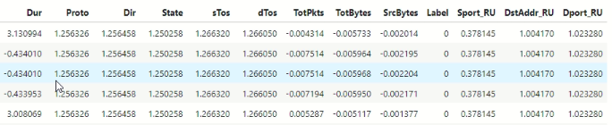
From 15 Features extracted into 13 Features
Figure: Feature used for input

Slide 8
Train and Test each file separately
Fusion
Model

Slide 9
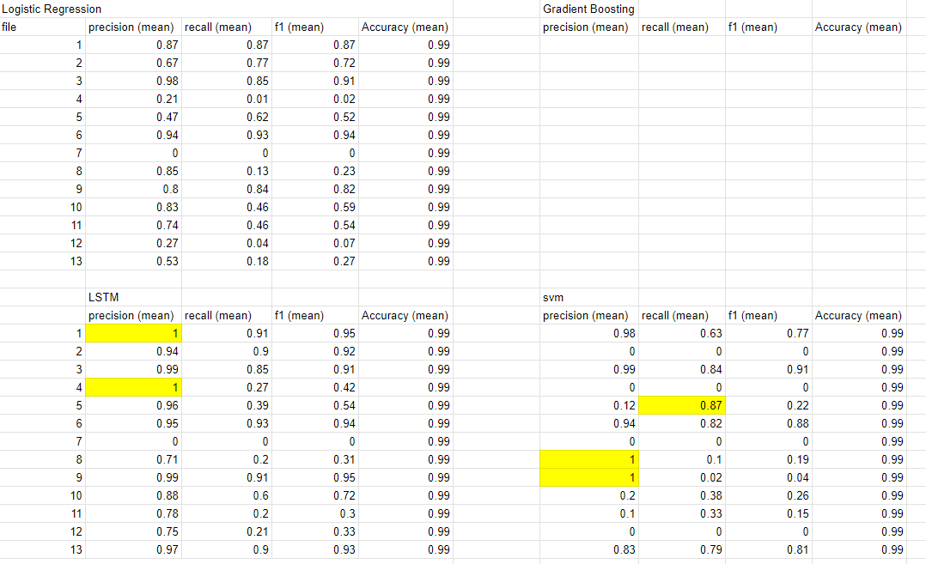
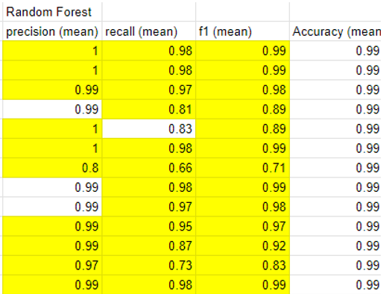
Method selection

Slide 10

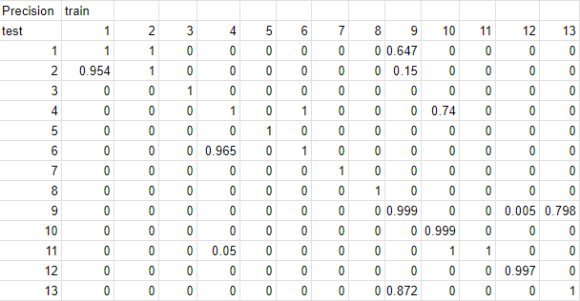
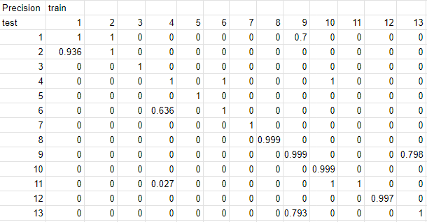
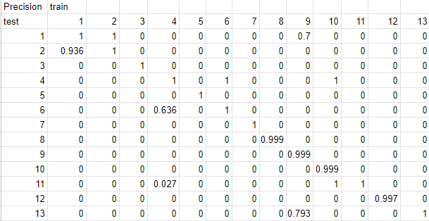
Result (Precision)
Table: Precision score of each model

Slide 11

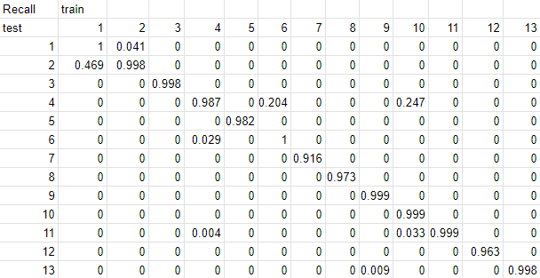
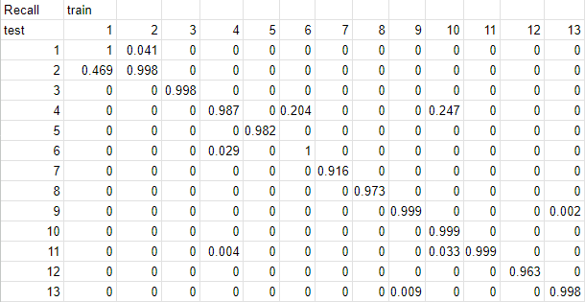
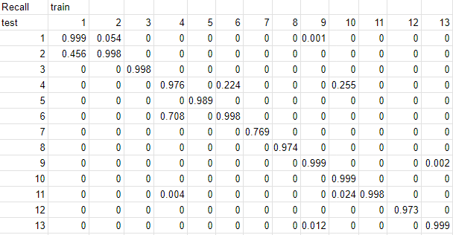
Result (Recall)
Table: Recall score of each model

Slide 12

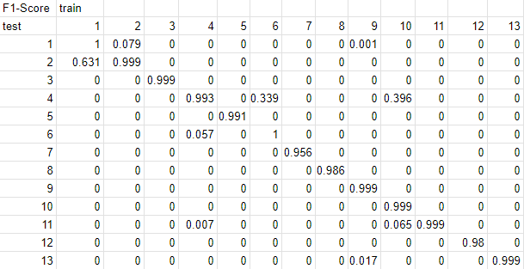
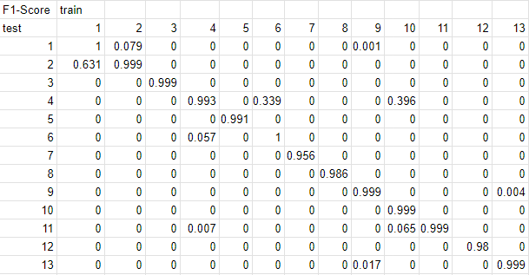
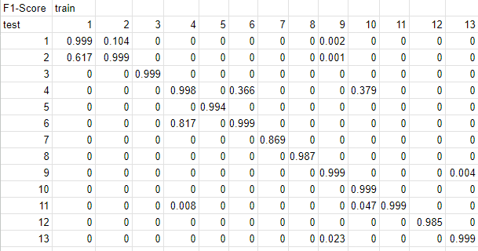
Result(F1-Score)
Table: F1-score of each model

Slide 13
Late Fusion Technique
Fusion
Model

Slide 14
Training Late Fusion
Train data 1
Train data 2
Train data 3
Train data 4
Train data 13
. . . . .
Model 1
Model 2
Model 3
Model 4
Model 13
. . . . . . .
Output 1
Output 2
Output 3
Output 4
Output 13
. . . . . . .

Slide 15
Testing Late Fusion
Testing Data
Model 1
Model 2
Model 3
Model 4
Model 13
. . . . . . .
Output 1
Output 2
Output 3
Output 4
Output 13
. . . . . . .
Logical OR
output

Slide 16
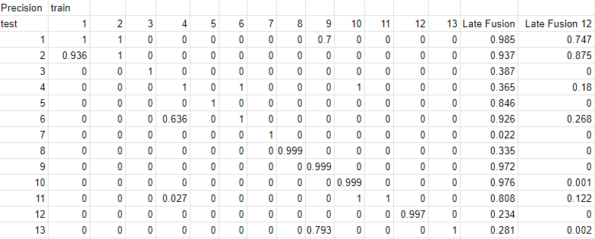
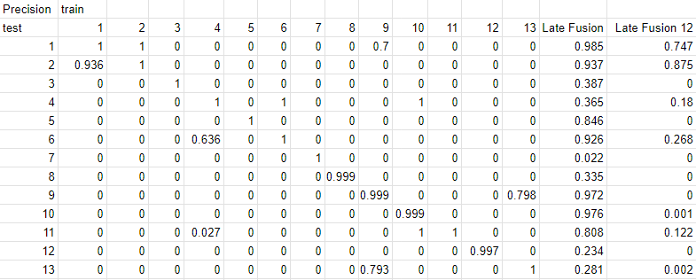
Result(Precision)
Table: Precision score of each model compare with Fusion all model and fusion 12 models

Slide 17
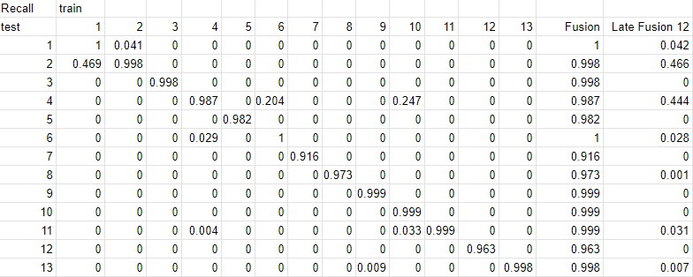
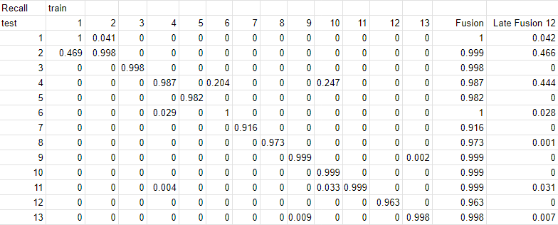
Result(Recall)
Table: Recall score of each model compare with Fusion all model and fusion 12 models

Slide 18
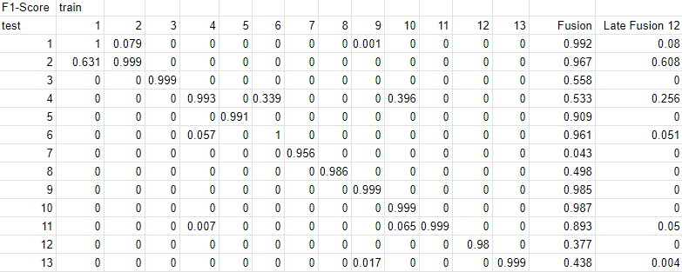
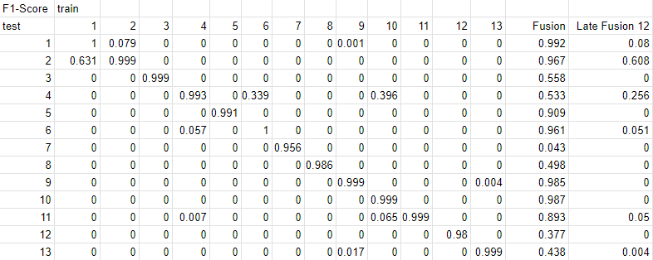
Result(F1-Score)
Table: F1 - score of each model compare with Fusion all model and fusion 12 models

Slide 19
Future Work
Try to do early fusion – merge all file at first for training 1 models

